Slide 1
QAYEMHA
FinTastic RealEstate
Submitted By :
Hissah ALowayyid Bashayer Alahmadi
Hadeel Albogami Hanan Alfouzan
Maram Alolaqi

Slide 2
Introduction
Suppose you have a house. And you want to sell it. Through Qaymeha you can predict the price based on the property’s dataset. And we make this prediction using Machine Learning model.
QAYEMHA
FINTASTIC REAL ESTATE

Slide 3
PROBLEM
SOLUTION
Difficulty in estimating the property price manually especially when there are several factors affecting the pricing.
Real Estate agents usually provide a higher price than the actual property value.
People usually spend numerous amount of time visiting different real estate agents offices.
House prices predictions are expected to help people who plan to buy a house so they can know the price range in the future, then they can plan their finance well from the comfort of their home. In addition, house price predictions are also beneficial for property investors to know the trend of housing prices in a certain location.

Slide 4
Model used
We used two machine learning techniques that help us to predict the house prices based on several features that concern both the investor and the client.
Linear Regression ( Accuracy of 58% )
Random Forest Regression ( Accuracy of 77% )
We ended up choosing the Random forest regression because it has more accuracy.

Slide 5
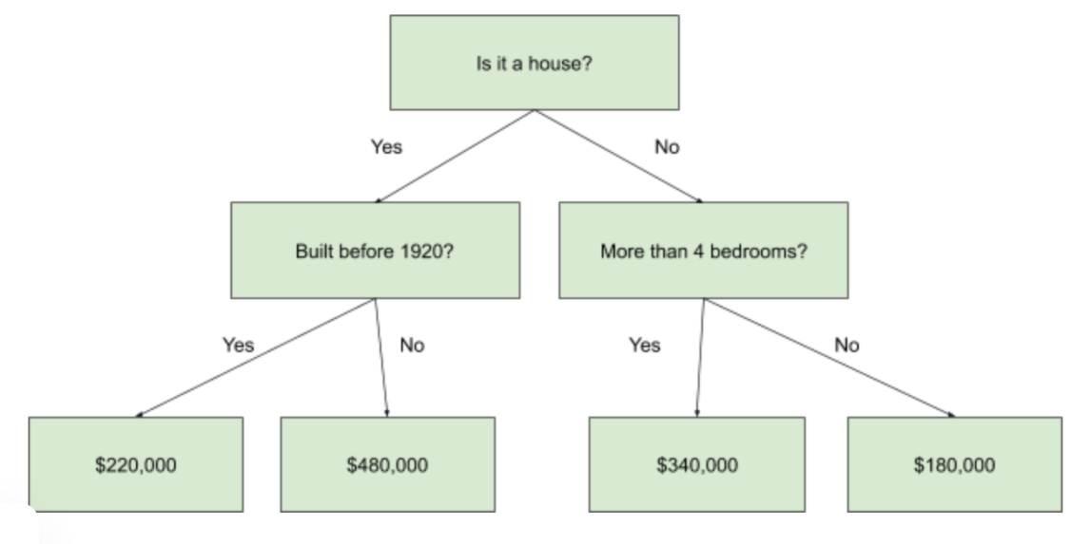
Decision Tree

Slide 6
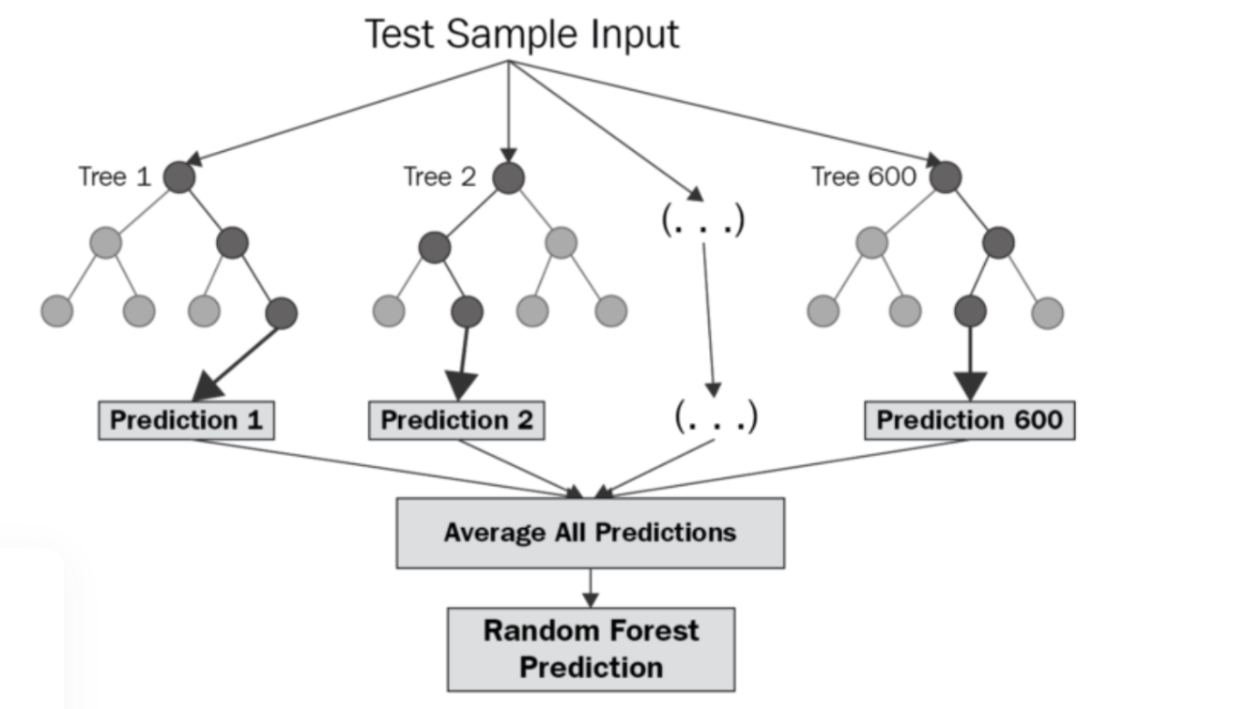
Model used

Slide 7


User Interface Prototype

Slide 8
Business Proposal

Slide 9
What we offer
Accurate Prices
With the use of our machine learning model we can predict an accurate price for the property.
PERSONALIZED
SEARCHING
users can browse properties for buying or leasing, residential, commercial and retail.
INVESTMENT
a separate section on the portal to list selected residential properties for crowdfunding.
RealEstate Hub
Connecting you with major real estate entities to insure the best customer experience.
BlockChain Technology
Tokenization platform for real estate assets.

Slide 10
Target market
Renter
Buyer
Investor
Seller or Property Owner
Who want to rent the Property
A potential buyer who is interested in a Property
Investors who want to invest in a property or partial investment or offering their investment for lease
Who sells or rents their property

Slide 11

Partnerships
Home visiting: Real Estate agents
Home Financing: Banks and p2p lending platforms,
Home insurance: Insurance companies
Credit Scoring: (SIMAH)

Slide 12
Revenue stream
Qayemha has multiple revenue streams from which it generates profit despite being free for the end-users.
Commission for buying, selling and displaying real estate on the application.
Advertising fees from real estate developers, instruction companies, interior designers and furnituring companies.

Slide 13
Future Work
Enhance the model accuracy by applying it on real Saudi housing data.
Develop an application for the model
Connecting target customers with major real estate entities to insure the best customer experience.
Tokenization platform for real estate assets.
Launching the full services, Well established business, recognizing profit.

Slide 14
THANKS

